Slide 1
Infrared Vision for Poultry Farms
By: Ankesh Raj ,IIT(ISM) Dhanbad
Prof. Xavier Maldague ,Univ. Laval(Canada)
https://www.linkedin.com/in/ankesh-raj-17a139107/ http://vision.gel.ulaval.ca/en/people/Id_13/index.php

Slide 2
Content
01
Problem Statement and significance
02
Proposed Idea
03
Equipments and Resources
04
Implementation
05
Experimental Results
06
Impact of my innovation

Slide 3

Problem Statement and Significance
2
1
-
Broiler Health
Economic aspect
Heat stress results in estimated total annual economic loss to the U.S. livestock production Industry of $1.69 to $2.36 billion; from this total, $128 to $165 million accurse in the poultry industry
Healthiness of broilers is one of the big concerns. Heat stress impairs overall poultry and egg production by modifying the bird’s neuro-endocrine profile by decreased feed intake
4
3
Effect on Production
Solution Specification
The market price of eggs and meat will decrease by increasing the product-ion of poultry farms. The availability of these items to the general public will also be significantly affected.
Require an effective, simple and economically applicable solution for the problem.

Slide 4
Proposed Idea
Poultry and Livestock
The main motto of this research axis is to make a compact system with the help of Low-end infrared cameras and mini computing devices for thermal image acquisitionion. Combining with the IoT and raspberry pi board, makes a powerful system connected with IR systems IR sensing capabilities become available. This system will be used in many places for monitoring thermal behaviour of subjects and environment.
01
02
The idea is to create an algorithm for pointing out the sick chicken among the other by making a bounding box around it. Similarly this concept can be used for monitoring other farms of pigs, cows and
turkey.
Since there are specific thermal features for unhealthy broilers and laying hen, that can help to find out the sick ones.
The other part of the project is to create a hotspot on a raspberry pi so that the live feed can be accessible to users.

Slide 5
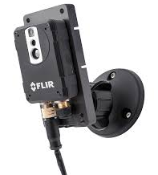
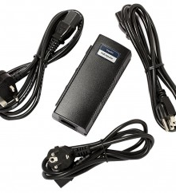

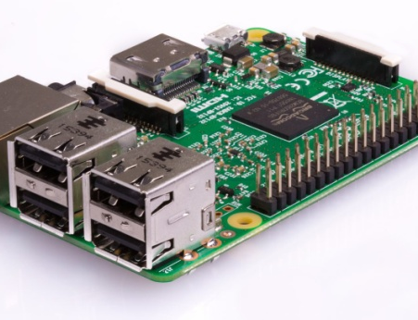
Equipment and Resources
Thermal Vision
Flir AX 8 Infrared
Raspberry Pi 3+
PoE injector
OpenCV & Python
Ethernet + 3 USB port
Power supply for camera
Thermal+Visible, with user
interface
For Programming

Slide 6

Implementation
Images are grabbed trough thermal camera
.
Key Idea :
Acquire Thermal images of scene
It is found that broiler body temperature increased three degrees Celsius (41- 44 C), and skin temperature increased 6 C (37-43 C) when exposed to heat stress (36 C) for three hours.
The developed algorithm works in such a way that all those birds who show any anomaly in thermal behaviour are spotted on the screen.
Similarly this concept can also be used for monitoring other farms of pigs, cows & turkey.
Streaming on phone or Desktop
Live Video on user mobile phone
Program will detect and draw bounding box on screen locating the sick bird
Locate the sick Broiler
Indicate to the owner
Set alarm to the user
For further analysis store the images in drive
Store the images with timestamp

Slide 7
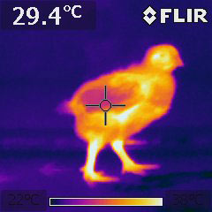
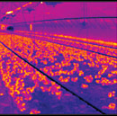
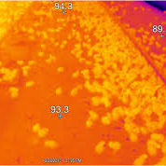
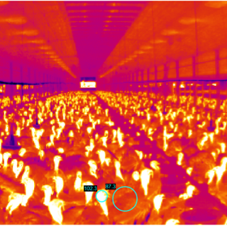
Experimental Result
Thermal Images reveals some unique feature that can not be seen through naked eyes. The thermal property of subject indicate it’s healthiness .
The following images are taken in different farms of Broiler and Turkey in Quebec province ,Canada

Slide 8
Impact of my innovation
Increase in Production
Broiler Health
Farm Owner
Production
Product Price
Economic growth
Production rate
More supply
General availability
My innovation can greatly reduce the loss of the poultry industry caused by heat stress. The market price of eggs and meat will decrease by increasing the production of poultry farms. The availability of these items to the general public will also be significantly affected. Applying the proposed system in farms will also reduce the human effort.
Thank you

